Slide 1

Climate Variability, Projections, and Impacts
Information Security Fundamentals | Climate Change (Impacts, Adaptation and Mitigation)
Course: Information Security Fundamentals | Chapter: Climate Change (Impacts, Adaptation and Mitigation) | Program: Bachelor of Engineering
DISCOVER · LEARN · EMPOWER
Notes:
Welcome to today's lecture on climate variability and extreme events. We will analyze how these phenomena drive the need for robust environmental policies. This session bridges the gap between theoretical projections and real-world impacts on our infrastructure and society.

Slide 2
Course Outcomes
SLIDE 2 / 14
Course Outcome
CO | BT LEVEL | DESCRIPTION
CO1 | BT4 | Recall, analyze and respond on fundamental environmental principles, such as ecological relationships and conservation strategies
CO2 | BT4 | Understand and analyze the interconnections between human activities and environmental impacts across different ecosystems
CO3 | BT4 | Understand and analyze and apply environmental laws and policies to analyse and propose solutions for real-world environmental challenges.
CO4 | BT2 | Students will analyse data from environmental monitoring programs to assess trends and predict future impacts on ecosystems.
CO5 | BT6 | Interpret, elaborate and propose various tools, design and innovative strategies for sustainable development and environmental conservation initiatives in securing the planet.
Chandigarh University
2 / 14
Notes:
Our primary focus for this lecture is Course Outcome 3. You must understand how to analyze environmental laws and apply them to propose solutions for the challenges posed by extreme climate events. This connects our technical understanding of climate data to legal and policy frameworks.

Slide 3
Learning Objectives
SLIDE 3 / 14
Learning Outcomes
1
Analyze the distinction between natural climate variability and anthropogenic climate change.
2
Evaluate the statistical significance of recent extreme weather events in India.
3
Interpret climate change projections using regional downscaling methods.
4
Assess the specific impacts of extreme events on engineering infrastructure.
5
Propose mitigation strategies based on projected climate scenarios for 2050.
Chandigarh University
3 / 14
Notes:
By the end of this session, you will be able to distinguish between natural variability and long-term climate change trends. We will evaluate how extreme events are becoming more frequent and intense. You will also learn to interpret complex climate projections and apply them to engineering challenges.

Slide 4
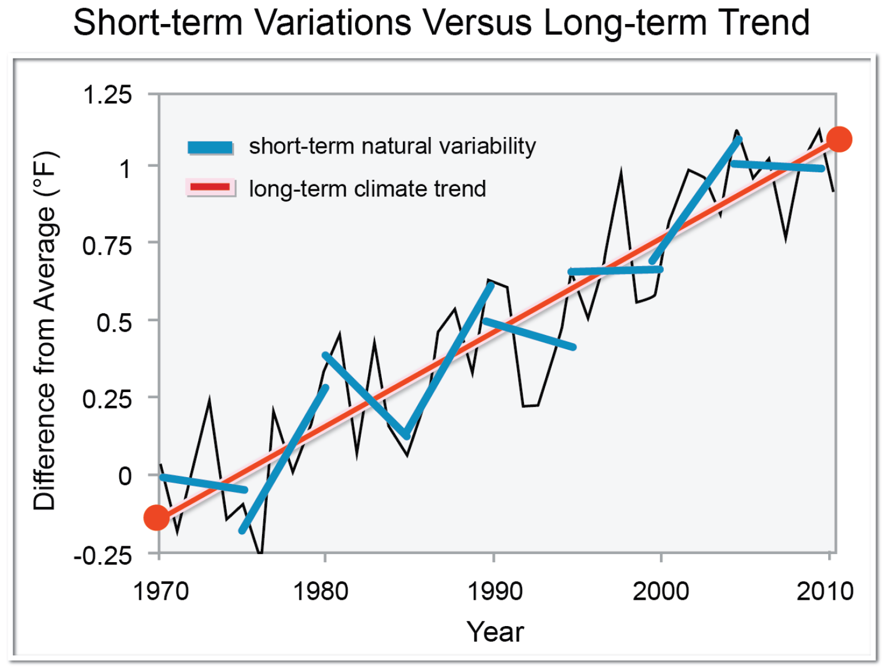
Lecture
SLIDE 4 / 14
Climate Variability vs. Climate Change
1
Climate variability refers to short-term fluctuations around a long-term average.
2
Climate change represents a persistent shift in the statistical properties of the climate.
3
Variability includes phenomena like El Niño and La Niña cycles.
4
Climate change is driven by increased greenhouse gas concentrations over decades.
5
Distinguishing the two is critical for attributing specific extreme events to human activity.
6
Short-term variability can mask or amplify long-term climate change trends.
7
Engineers must design for both the baseline variability and the shifting mean.
File:Global warming. Short-term variations versus a long-term trend (NCADAC).png - Wikimedia Commons
Chandigarh University
4 / 14
Notes:
Think of climate variability as the daily noise in a signal, while climate change is the underlying trend. For example, a cold winter does not disprove global warming if the long-term average is rising. We must separate natural cycles like El Niño from the anthropogenic forcing to design resilient systems.

Slide 5
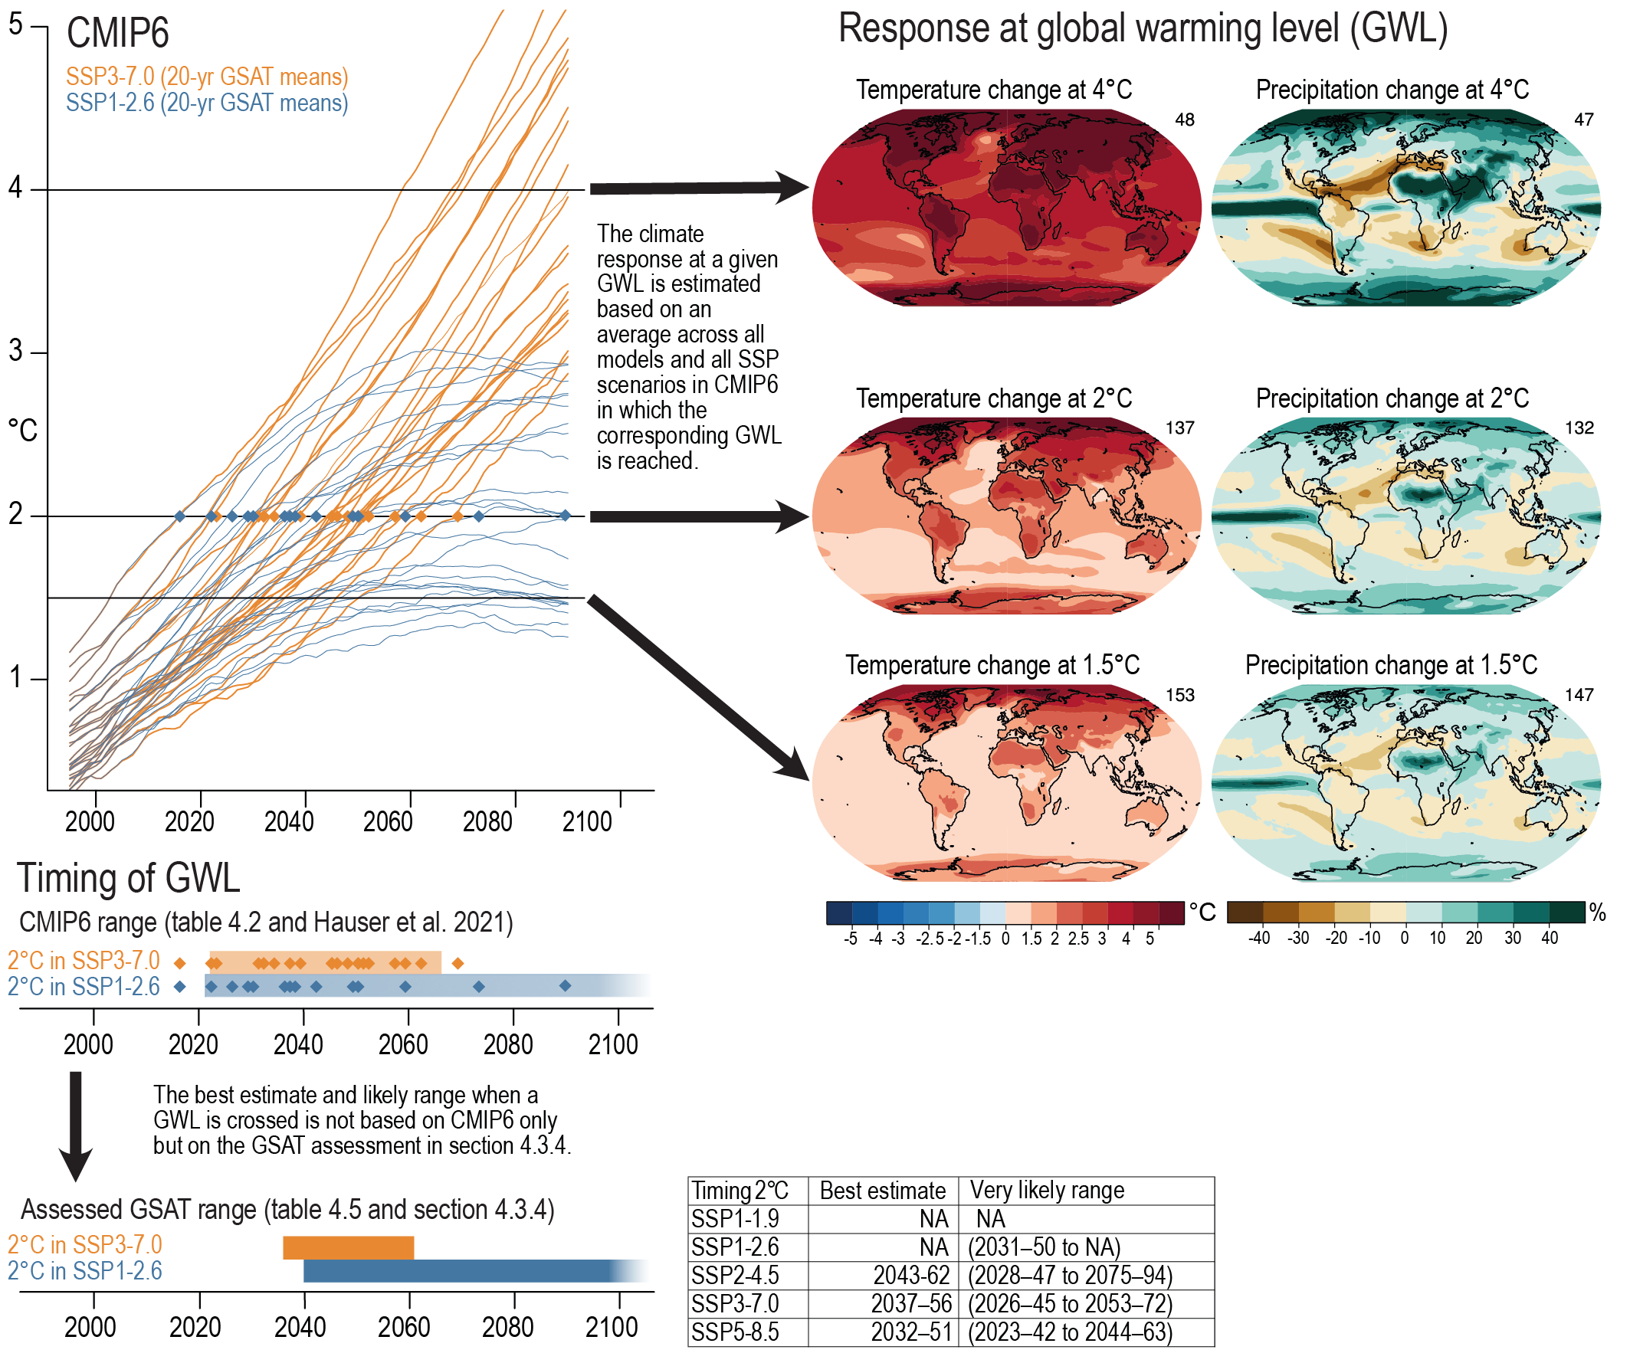
Extreme Events
SLIDE 5 / 14
Definitions and Types
1
Extreme events are rare occurrences that deviate significantly from historical norms.
2
Heatwaves are defined as periods of abnormally hot weather lasting days.
3
Extreme precipitation involves rainfall intensity exceeding the 90th percentile of history.
4
Cyclones and hurricanes are characterized by sustained high wind speeds and low pressure.
5
Droughts represent prolonged periods of abnormally low rainfall and water scarcity.
6
The frequency of these events is increasing due to a warmer atmosphere.
7
Engineering standards must now account for these non-stationary extreme conditions.
Chapter 11: Weather and Climate Extreme Events in a Changing Climate | Climate Change 2021: The Physical Science Basis (source: ipcc.ch)
Chandigarh University
5 / 14
Notes:
We define extreme events as those falling in the tails of the probability distribution. A heatwave is not just a hot day; it is a sustained period where temperatures exceed the 90th percentile. As the climate warms, the baseline shifts, making these extremes more frequent and severe for our infrastructure.

Slide 6
Climate Change Projections
SLIDE 6 / 14
Methodology
1
Projections rely on Global Climate Models (GCMs) simulating atmospheric physics.
2
Scenarios like RCP 4.5 and RCP 8.5 define future greenhouse gas pathways.
3
Regional Climate Models (RCMs) downscale global data for local accuracy.
4
Projections estimate changes in mean temperature, precipitation, and extreme indices.
5
Uncertainty arises from emission scenarios, model physics, and internal variability.
6
Engineers use ensemble averages to reduce uncertainty in design parameters.
7
Projections guide the selection of safety factors for critical infrastructure.
Chapter 11: Weather and Climate Extreme Events in a Changing Climate | Climate Change 2021: The Physical Science Basis (source: ipcc.ch)
Chandigarh University
6 / 14
Notes:
We use Global Climate Models to simulate the Earth's system under different emission scenarios. However, global models are too coarse for local engineering projects. We use Regional Climate Models to downscale this data, providing the resolution needed for designing a specific dam or drainage system in Chandigarh.

Slide 7
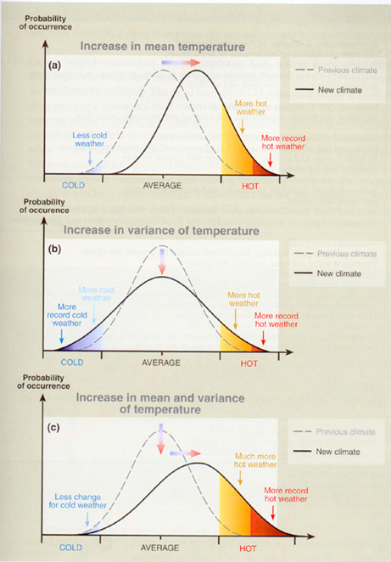
Worked Example
SLIDE 7 / 14
Heatwave Intensity Calculation
GOVERNING EQUATION
Historical mean summer max temp (T_mean) = 38°C with σ = 2°C
FORMULA
P(X > T_extreme) = 1 - Φ((T_extreme - μ_new) / σ).
• Projected increase by 2050 (ΔT) = +3.5°C based on RCP 8.5.
• New projected mean = 38°C + 3.5°C = 41.5°C.
• Extreme threshold (T_extreme) = T_mean + 2σ = 38 + 4 = 42°C.
• Probability of exceeding threshold increases from 2.5% to ~15%.
• This shift requires redesigning cooling systems for higher ambient loads.
Projections for Extreme Weather – ACER (source: acer-acre.ca)
Chandigarh University
7 / 14
Notes:
Let's calculate the impact on a cooling system. If the historical mean is 38°C with a standard deviation of 2°C, an extreme event is 42°C. With a projected warming of 3.5°C, the new mean is 41.5°C. The probability of exceeding 42°C jumps from 2.5% to 15%, drastically increasing the load on HVAC systems.

Slide 8
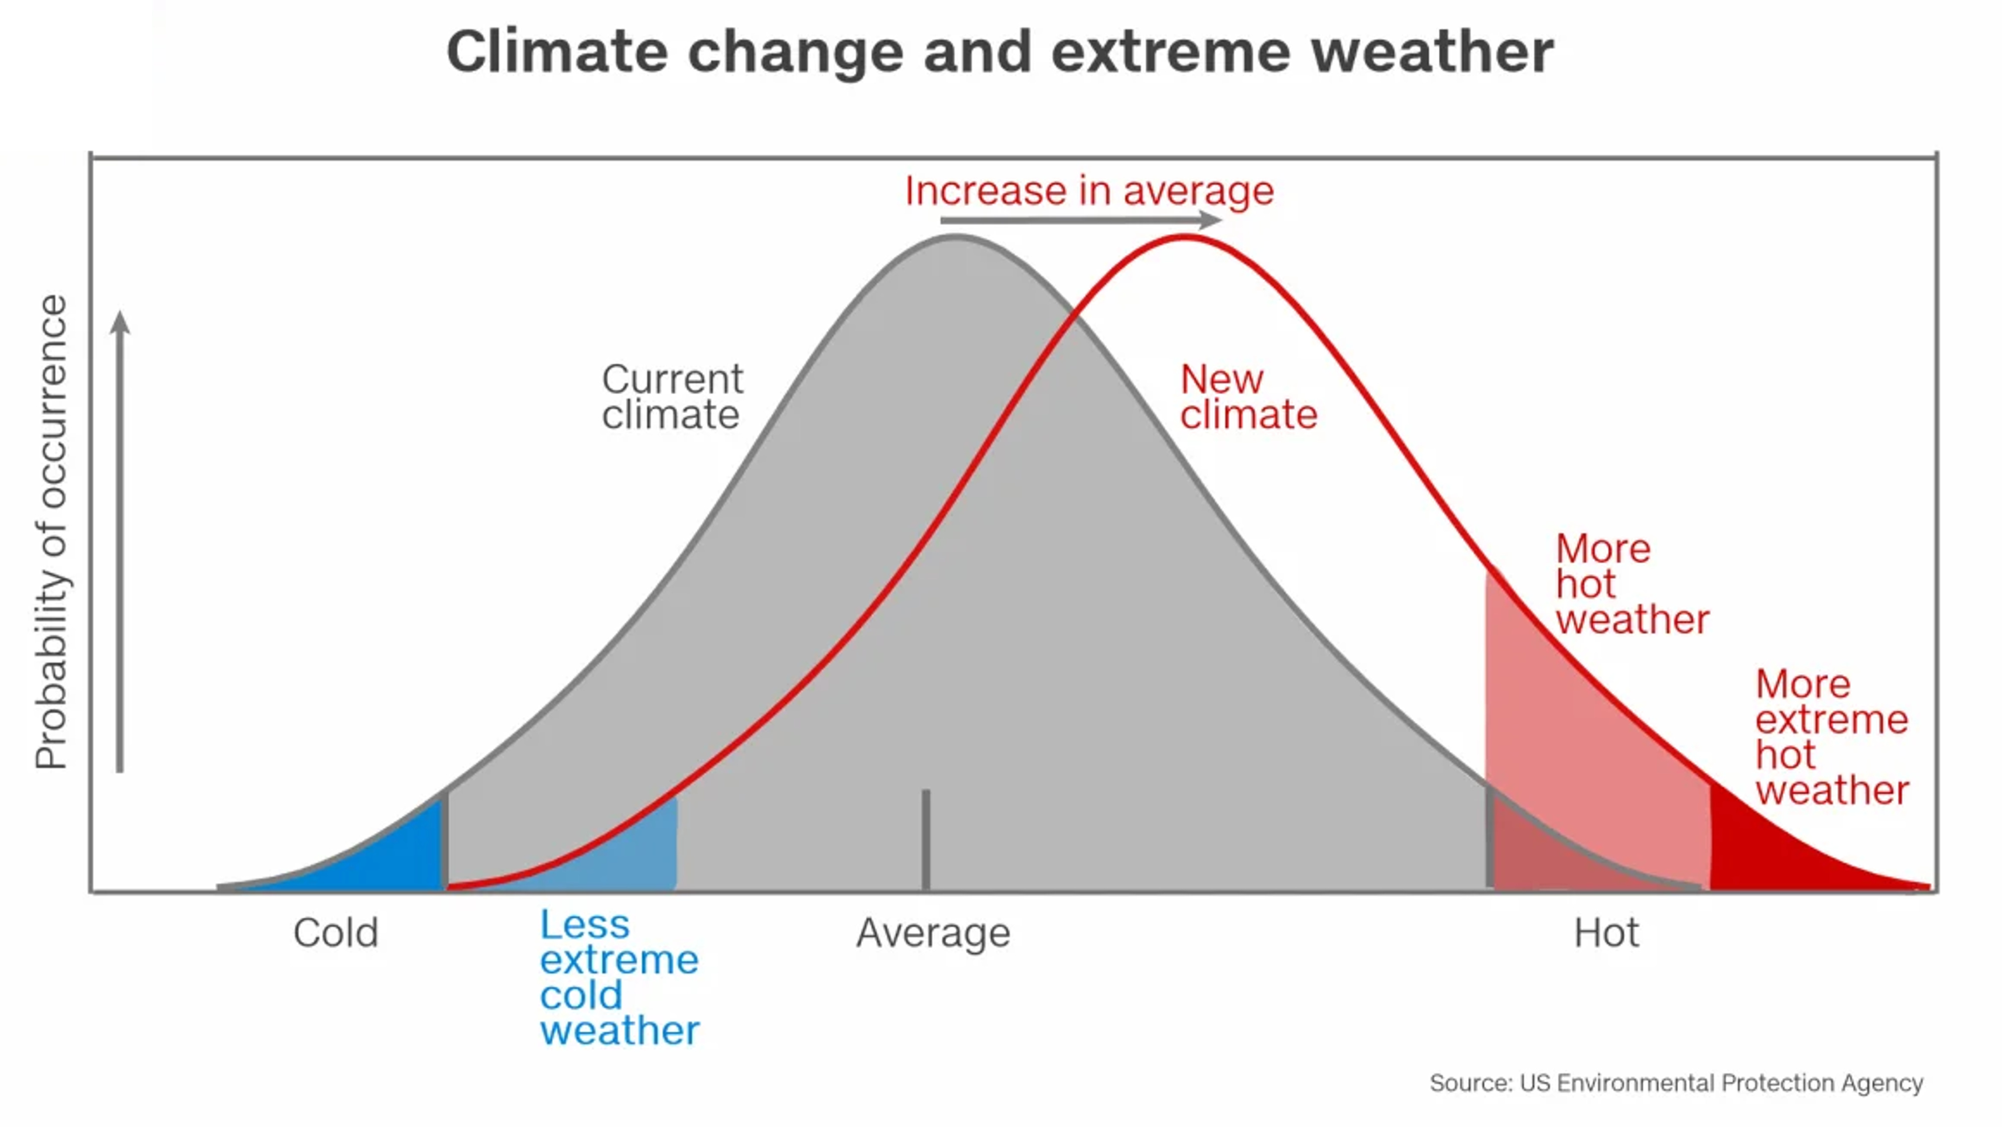
Impacts
SLIDE 8 / 14
Hydrological and Water Resources
1
Altered precipitation patterns lead to more frequent flash floods and droughts.
2
Glacial melt accelerates, causing short-term flooding and long-term water scarcity.
3
Groundwater recharge rates decrease due to reduced infiltration during dry spells.
4
Water quality degrades due to higher temperatures and increased runoff pollutants.
5
Reservoir operation rules must adapt to variable inflow and evaporation rates.
6
Urban drainage systems face overflow risks from intense short-duration rainfall.
7
Agricultural irrigation demands shift seasonally, affecting food security.
The Underappreciated Importance of Climate Variability (source: substackcdn.com)
Chandigarh University
8 / 14
Notes:
The hydrological cycle is intensifying, leading to a 'wet gets wetter, dry gets drier' pattern. Glacial melt provides a temporary surge in water but threatens long-term availability. For engineers, this means designing reservoirs and drainage systems that can handle both extreme flooding and prolonged droughts simultaneously.

Slide 9
Impacts
SLIDE 9 / 14
Infrastructure and Built Environment
1
Thermal expansion causes buckling in railway tracks and road pavements.
2
Foundation stability is compromised by soil moisture changes and permafrost thaw.
3
Coastal infrastructure faces erosion and inundation from rising sea levels.
4
Power grids suffer reduced efficiency and increased failure during heatwaves.
5
Building materials degrade faster under increased UV radiation and humidity.
6
Transportation networks face disruptions from extreme weather events.
7
Design codes must incorporate climate-adjusted load factors for safety.
Projections for Extreme Weather – ACER (source: acer-acre.ca)
Chandigarh University
9 / 14
Notes:
Infrastructure is designed for historical climate data, which is no longer valid. Thermal expansion can buckle railway tracks, and soil moisture changes can undermine building foundations. Coastal cities face direct threats from sea-level rise. We must update design codes to include climate-adjusted load factors to ensure safety.

Slide 10
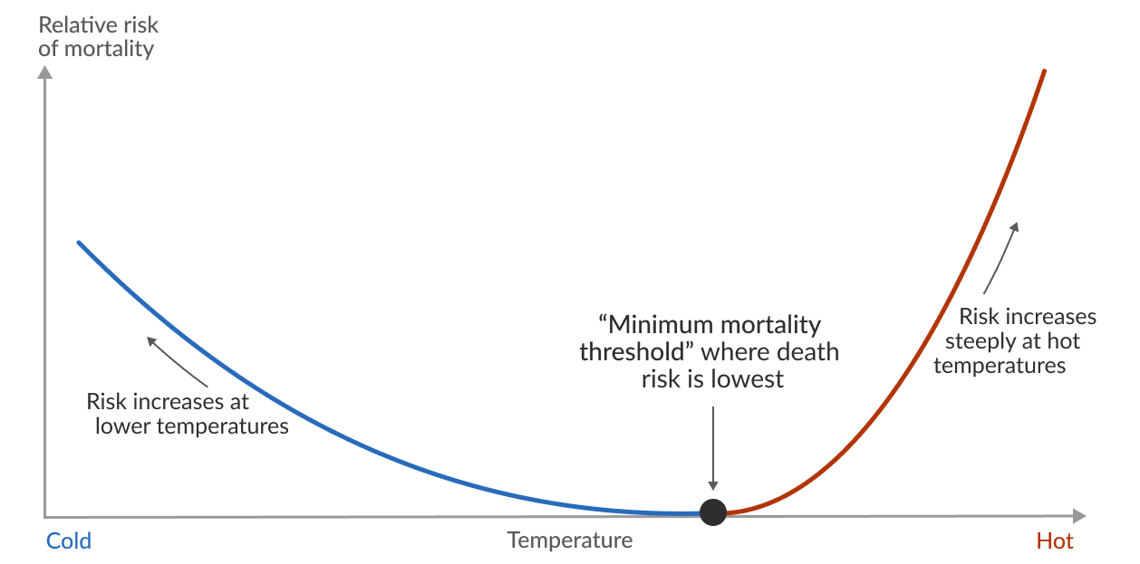
Impacts
SLIDE 10 / 14
Human Health and Safety
1
Heat stress increases mortality rates among vulnerable populations.
2
Vector-borne diseases expand their geographic range due to warmer temperatures.
3
Air quality deteriorates as higher temperatures accelerate ozone formation.
4
Mental health impacts arise from climate anxiety and displacement trauma.
5
Displacement from extreme events creates refugee and housing crises.
6
Public health infrastructure must be resilient to surge capacity demands.
7
Early warning systems are critical for reducing loss of life.
Source: ourworldindata.org
Chandigarh University
10 / 14
Notes:
The human cost of climate change is profound. Heat stress is a direct killer, while changing temperatures expand the range of diseases like malaria. Air quality worsens as heat accelerates ozone formation. We must design public health infrastructure that can handle surge capacities during these extreme events.

Slide 11
Lecture
SLIDE 11 / 14
Common Pitfalls in Climate Analysis
1
Confusing short-term variability with long-term climate change trends.
2
Using historical data alone for designing future infrastructure projects.
3
Ignoring the non-stationary nature of extreme event probabilities.
4
Overlooking the compounding effects of multiple simultaneous hazards.
5
Failing to account for regional differences in climate projections.
6
Underestimating the rate of feedback loops in the climate system.
7
Neglecting the socio-economic dimensions of climate adaptation strategies.
The Underappreciated Importance of Climate Variability (source: substackcdn.com)
Chandigarh University
11 / 14
Notes:
A common pitfall is using historical data to design for the future, assuming the climate is stationary. We must recognize that the probability of extreme events is changing. Another error is ignoring compounding hazards, where a flood and a heatwave occur simultaneously, overwhelming our systems.

Slide 12
Lecture
SLIDE 12 / 14
Adaptation Strategies for Engineers
1
Implementing green infrastructure to manage stormwater and reduce heat.
2
Designing flexible infrastructure that can be upgraded as conditions change.
3
Using climate-resilient materials that withstand higher temperatures and moisture.
4
Developing early warning systems for extreme weather events.
5
Integrating nature-based solutions into urban planning and design.
6
Conducting regular risk assessments to update safety protocols.
7
Collaborating with policymakers to enforce adaptive building codes.
Chandigarh University
12 / 14
Notes:
Adaptation requires a shift from static design to flexible, resilient systems. We can use green infrastructure to manage stormwater and reduce urban heat islands. Materials must be selected for their ability to withstand changing conditions. Collaboration with policymakers is essential to enforce adaptive building codes that reflect current projections.

Slide 13

Lecture
SLIDE 13 / 14
Key Takeaways
1
Distinguish between natural variability and anthropogenic climate change trends.
2
Extreme events are becoming more frequent and intense due to warming.
3
Climate projections require downscaling for local engineering applications.
4
Impacts span hydrology, infrastructure, and human health sectors.
5
Adaptation requires flexible design and updated safety factors.
Source: slidemodel.com
Chandigarh University
13 / 14
Notes:
To summarize, we must distinguish between variability and change. Extreme events are intensifying, requiring us to use downscaled projections for local design. The impacts are widespread, affecting water, infrastructure, and health. Finally, adaptation requires flexible design and updated safety factors to ensure resilience.

Slide 14
Lecture
SLIDE 14 / 14
References
ENVIRONMENTAL STUDIES
From Crisis to Cure — R. Rajagopalan
• Environmental Science and Engineering — Benny Joseph
• Environmental Studies — R.C. Sharma and D. Gurbir Sangha
• Introduction to Environmental Science — Anjaneyulu, Y.
• Environmental Pollution Control Engineering — C.S. Rao
• Textbook of Environmental Studies for undergraduate courses — E. Bharucha
• Environmental Science — S.C. Santra
Chandigarh University
14 / 14
Notes:
These references provide the foundational knowledge for understanding environmental laws and engineering solutions. I encourage you to consult these texts for deeper insights into climate adaptation and policy frameworks. They are essential for your future work in addressing real-world environmental challenges.

